Slide 1

Department of Computer Science
Mini Project
On
Explainable AI for Multiple Sclerosis Subtype Classification with Counterfactual Explanations
Presented by:
Mohammed Mustafa (160923753001)
Syed Atha Ullah Shareef (160923753002)
Mohammed Mustaqeem Uddin (160923753017)
Guide Name:
Mrs. Hajira Sabuhi
Assistant Professor

Slide 2

Contents
Abstract
Introduction
Literature Survey
Existing System
Proposed System
Methodology
Implementation
Result
Conclusion
References

Slide 3
Abstract
This project presents an advanced, explainable machine learning framework for accurately classifying multi-class Multiple Sclerosis (MS) subtypes. Differentiating between MS variants—such as Relapsing-Remitting or Primary Progressive—is clinically complex but essential for delivering personalized treatments. By leveraging an augmented clinical dataset, the proposed system evaluates high-performance algorithms, including XGBoost and RandomForest, to quickly categorize the disease state. Crucially, the system integrates Explainable AI (XAI) tools like SHAP and DiCE to provide clear feature importance and actionable counterfactual scenarios, ultimately empowering clinicians with transparent, data-driven diagnostic support.
Mustafa

Slide 4
2. Introduction
Multiple Sclerosis (MS) is a complex neurological disease that manifests in several distinct clinical subtypes.
Traditional manual diagnosis requires time-consuming clinical observations and can be prone to human variability.
Integrating Artificial Intelligence allows for the rapid, data-driven categorization of these complicated MS subtypes.
Our project introduces Explainable AI to ensure that model predictions are completely transparent to Clinicians.
Mustaqeem

Slide 5
3. Literature Survey
(2026) Title: Machine Learning Analysis Applied to Prediction of Progression Independent of Relapse Activity (PIRA) in Multiple Sclerosis Patients Authors: Poretto et al. Link: https://pmc.ncbi.nlm.nih.gov/articles/PMC12661373/
Focuses on predicting PIRA (relapse-independent disability progression)
Uses clinical and MRI-based features with ML models
(2024) Title: Predictors of Short-Term, Relapse-Independent Disease Progression in Multiple Sclerosis Using Machine Learning Authors: Pérez-Miralles et al. Link: https://www.sciencedirect.com/science/article/pii/S0022510X26001280
Predicts short-term PIRA risk (24–36 months)
Uses clinical + MRI features
Research Gap
Limited focus on Explainable AI (XAI) in existing models
Lack of actionable insights for clinical improvement
Need for personalized and interpretable predictions
Atha

Slide 6
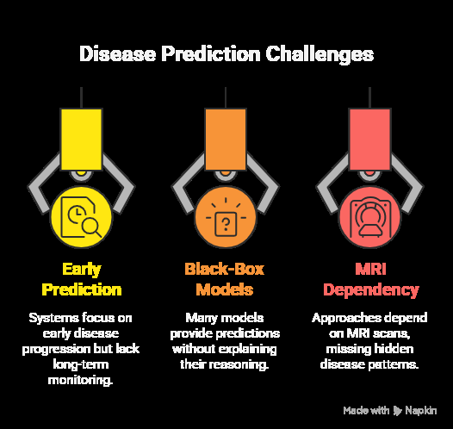
4. Existing System
Mustafa

Slide 7
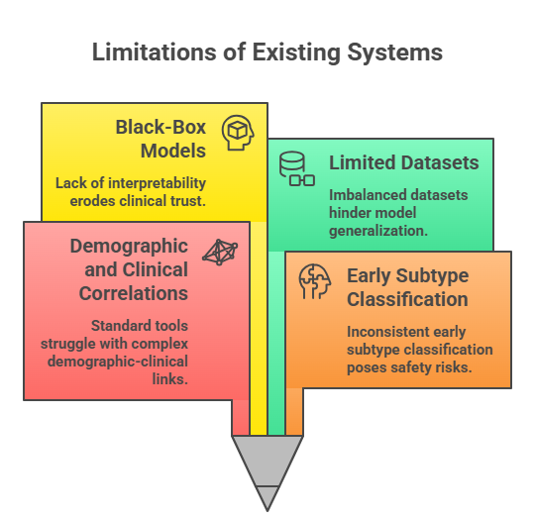
4.1. Limitations of Existing System
Mustafa

Slide 8
5. Proposed System
An intelligent classification system that automatically identifies distinct MS subtypes using advanced Machine Learning models.
Integrates Explainable AI (XAI) techniques such as SHAP to clearly interpret and justify model predictions.
Utilizes DiCE (Diverse Counterfactual Explanations) to provide actionable insights by suggesting changes in clinical features that could alter the predicted outcome.
Atha

Slide 9
5.1. Problem Statement
Accurately classifying Multiple Sclerosis (MS) subtypes based on complex clinical and demographic data remains a challenging task due to subtle variations and overlapping patterns.
There is a vital need for a transparent and interpretable automated system that supports clinicians by providing clear explanations, rather than functioning as a “black-box” model.
Atha

Slide 10
5.2. Objectives
To build and evaluate high-performance multi-class ML models (like XGBoost and Random Forest) on clinical MS data.
To implement explainability tools that provide both global feature importance and actionable clinical insights.
To drastically reduce the diagnostic delay for patients requiring immediate subtype-specific therapies.
Mustaqeem

Slide 11
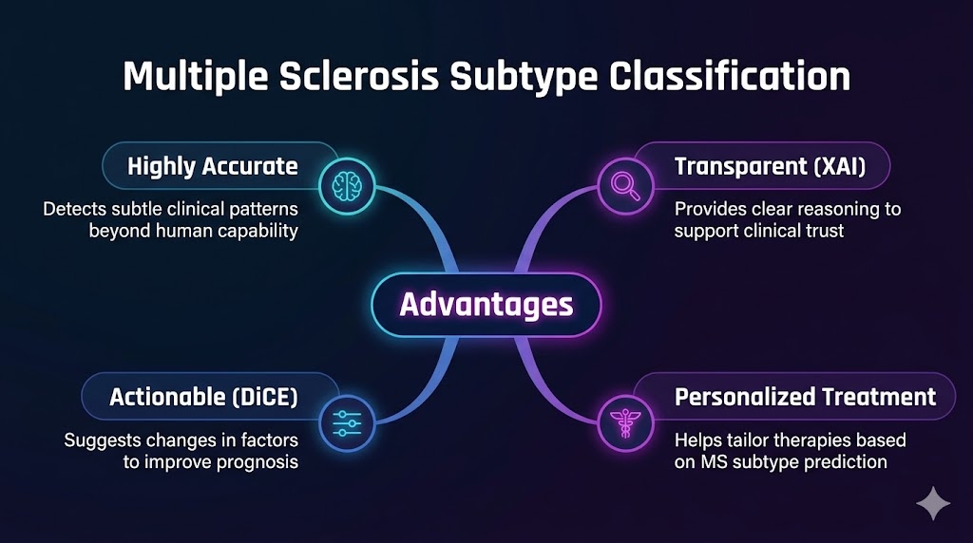
5.3. Advantages of Proposed System
Mustaqeem

Slide 12
6. Methodology
Extracted and rigorously cleaned the initial clinical dataset, ensuring all patient and demographic variables were properly encoded.
Handled training using a strict 5-Fold Stratified Cross-Validation to guarantee that the multi-class models generalized perfectly without overfitting.
Trained and thoroughly evaluated five advanced algorithms, meticulously tracking Accuracy, Macro F1, and Weighted F1 statistics for each.
Achieved the absolute best performance empirically with XGboost, scoring a 0.8952 test accuracy.
Embedded transparent XAI tools—specifically SHAP and DiCE—directly into the highest-performing algorithms to provide clinicians with clear feature importance and actionable counterfactual scenarios.
Mustafa

Slide 13

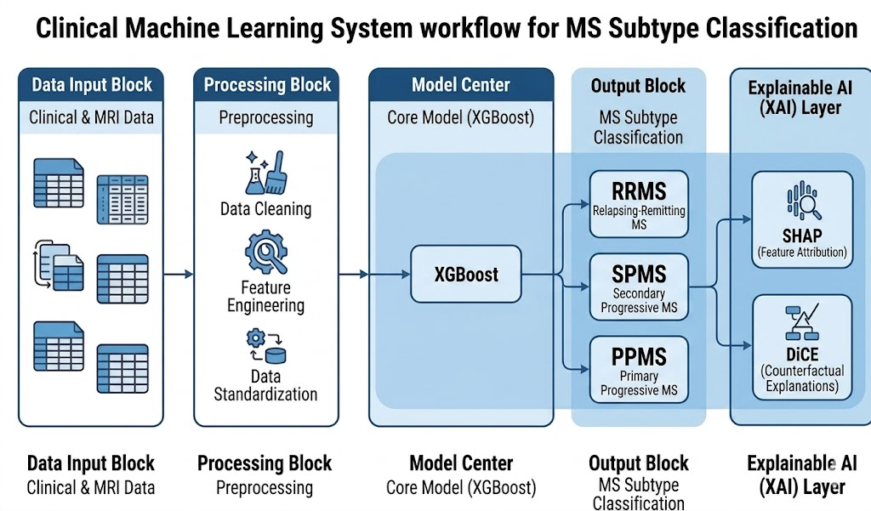
6.1. System Architecture
Mustaqeem

Slide 14

6.2. Technology Used
Mustaqeem

Slide 15
6.3. Datasets
Data Scope: Curated a comprehensive multiple-class clinical dataset encompassing various demographic, historical, and clinical scoring variables for Multiple Sclerosis.
Target Categories: Categorized patient records strictly into three distinct medical sub-stages: RRMS, PPMS, and SPMS.
Initial Imbalance Identified: Diagnosed severe numerical bias and underrepresentation specifically within the Primary Progressive (PPMS) subtype, which originally held only 100 samples.
Atha

Slide 16
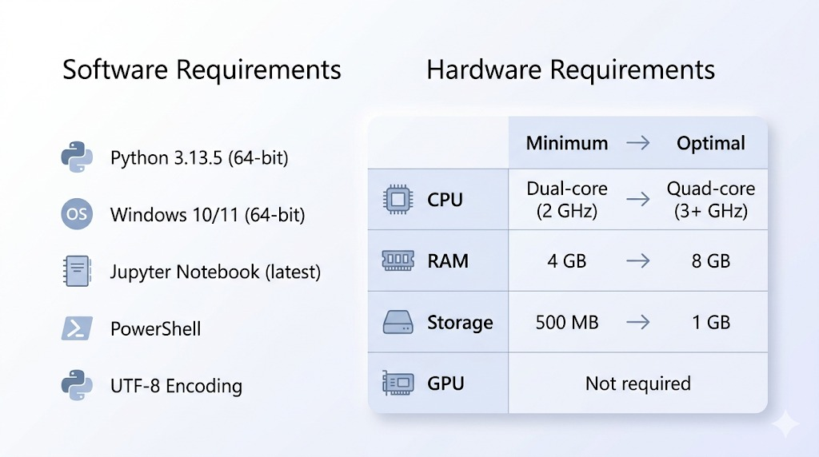
7. Implementation
Mustafa

Slide 17
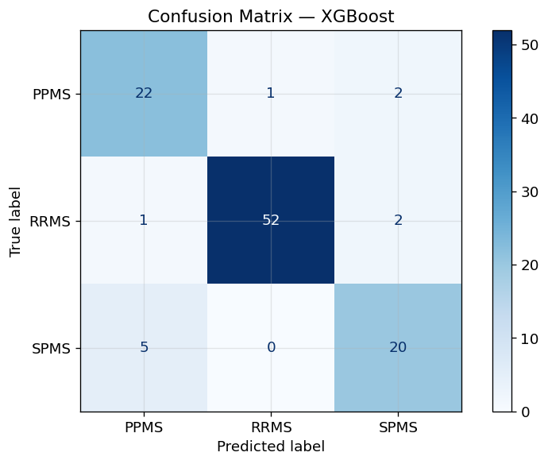
8.Results
XGBoost
Mustaqeem

Slide 18
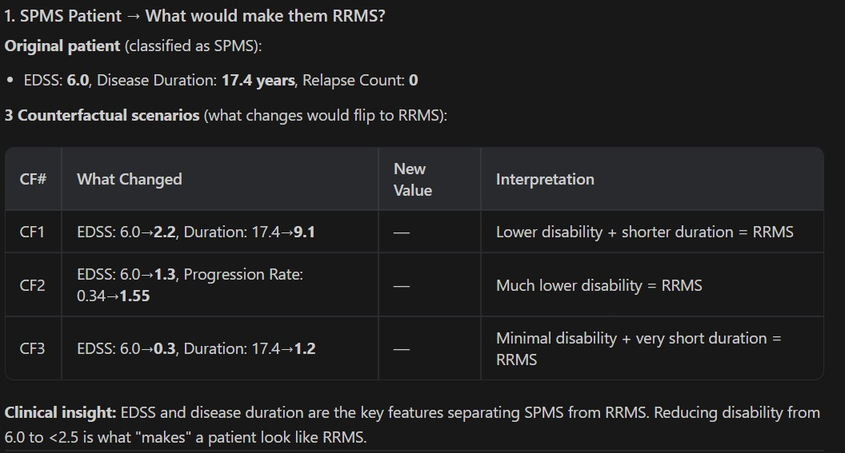
Counterfactual Explanations using Dice
Msutafa

Slide 19
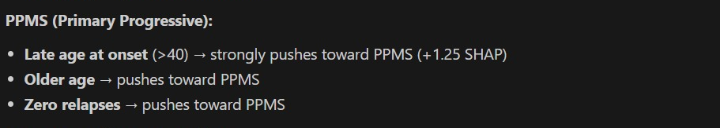
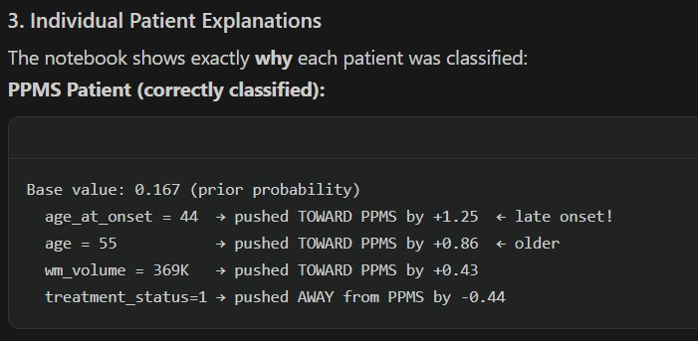
SHAP Explanation's
Atah

Slide 20
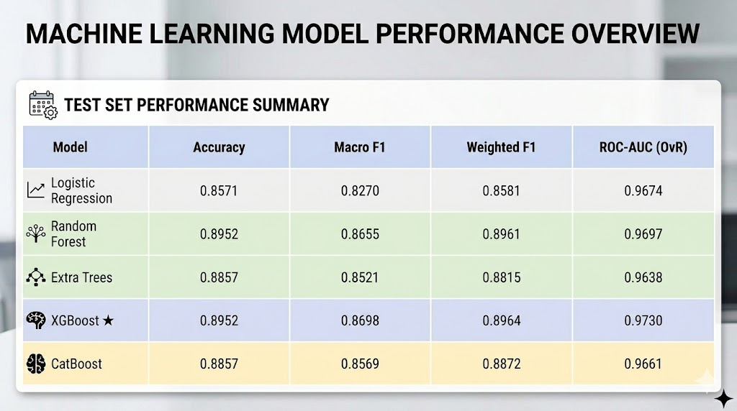
Comparisons of ML techniques
Mustaqeem

Slide 21
9. Conclusion
Our ML framework successfully establishes a highly reliable method for multi-class MS subtype classification.
Introducing XAI bridges the critical gap between complex algorithms and practical, everyday clinical trust.
This transparent classification system will definitively pave the way for faster, highly personalized neurological care.
Mustafa

Slide 22
10.References
Lublin, F.D., et al. (2014). "Defining the clinical course of multiple sclerosis: The 2013 revisions." Neurology, 83(3), 278-286. 🔗 https://doi.org/10.1212/WNL.0000000000000560
Thompson, A.J., et al. (2018). "Diagnosis of multiple sclerosis: 2017 revisions of the McDonald criteria." The Lancet Neurology, 17(2), 162-173.
🔗 https://doi.org/10.1016/S1474-4422(17)30470-2
Chen, T., & Guestrin, C. (2016). "XGBoost: A Scalable Tree Boosting System." Proceedings of the 22nd ACM SIGKDD, 785-794. 🔗 https://doi.org/10.1145/2939672.2939785
Mothilal, R.K., Sharma, A., & Tan, C. (2020). "Explaining Machine Learning Classifiers through Diverse Counterfactual Explanations." ACM Conference on Fairness, Accountability, and Transparency (FAT*). 🔗 https://arxiv.org/abs/1905.07697
Lundberg, S.M., & Lee, S.I. (2017). "A Unified Approach to Interpreting Model Predictions." Advances in Neural Information Processing Systems (NeurIPS), 30. 🔗 https://arxiv.org/abs/1705.07874
Pedregosa, F., et al. (2011). "Scikit-learn: Machine Learning in Python." Journal of Machine Learning Research, 12, 2825-2830. 🔗 https://jmlr.org/papers/v12/pedregosa11a.html
Atha

Slide 23
Thank You

